Slide 1

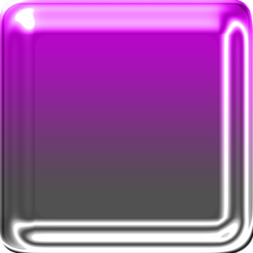

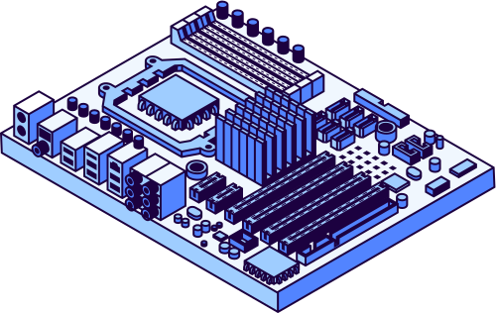

studio shodwe
Home
About us
Startegy
Contact
BASICS OF
MOTHERBOARDS

Slide 2

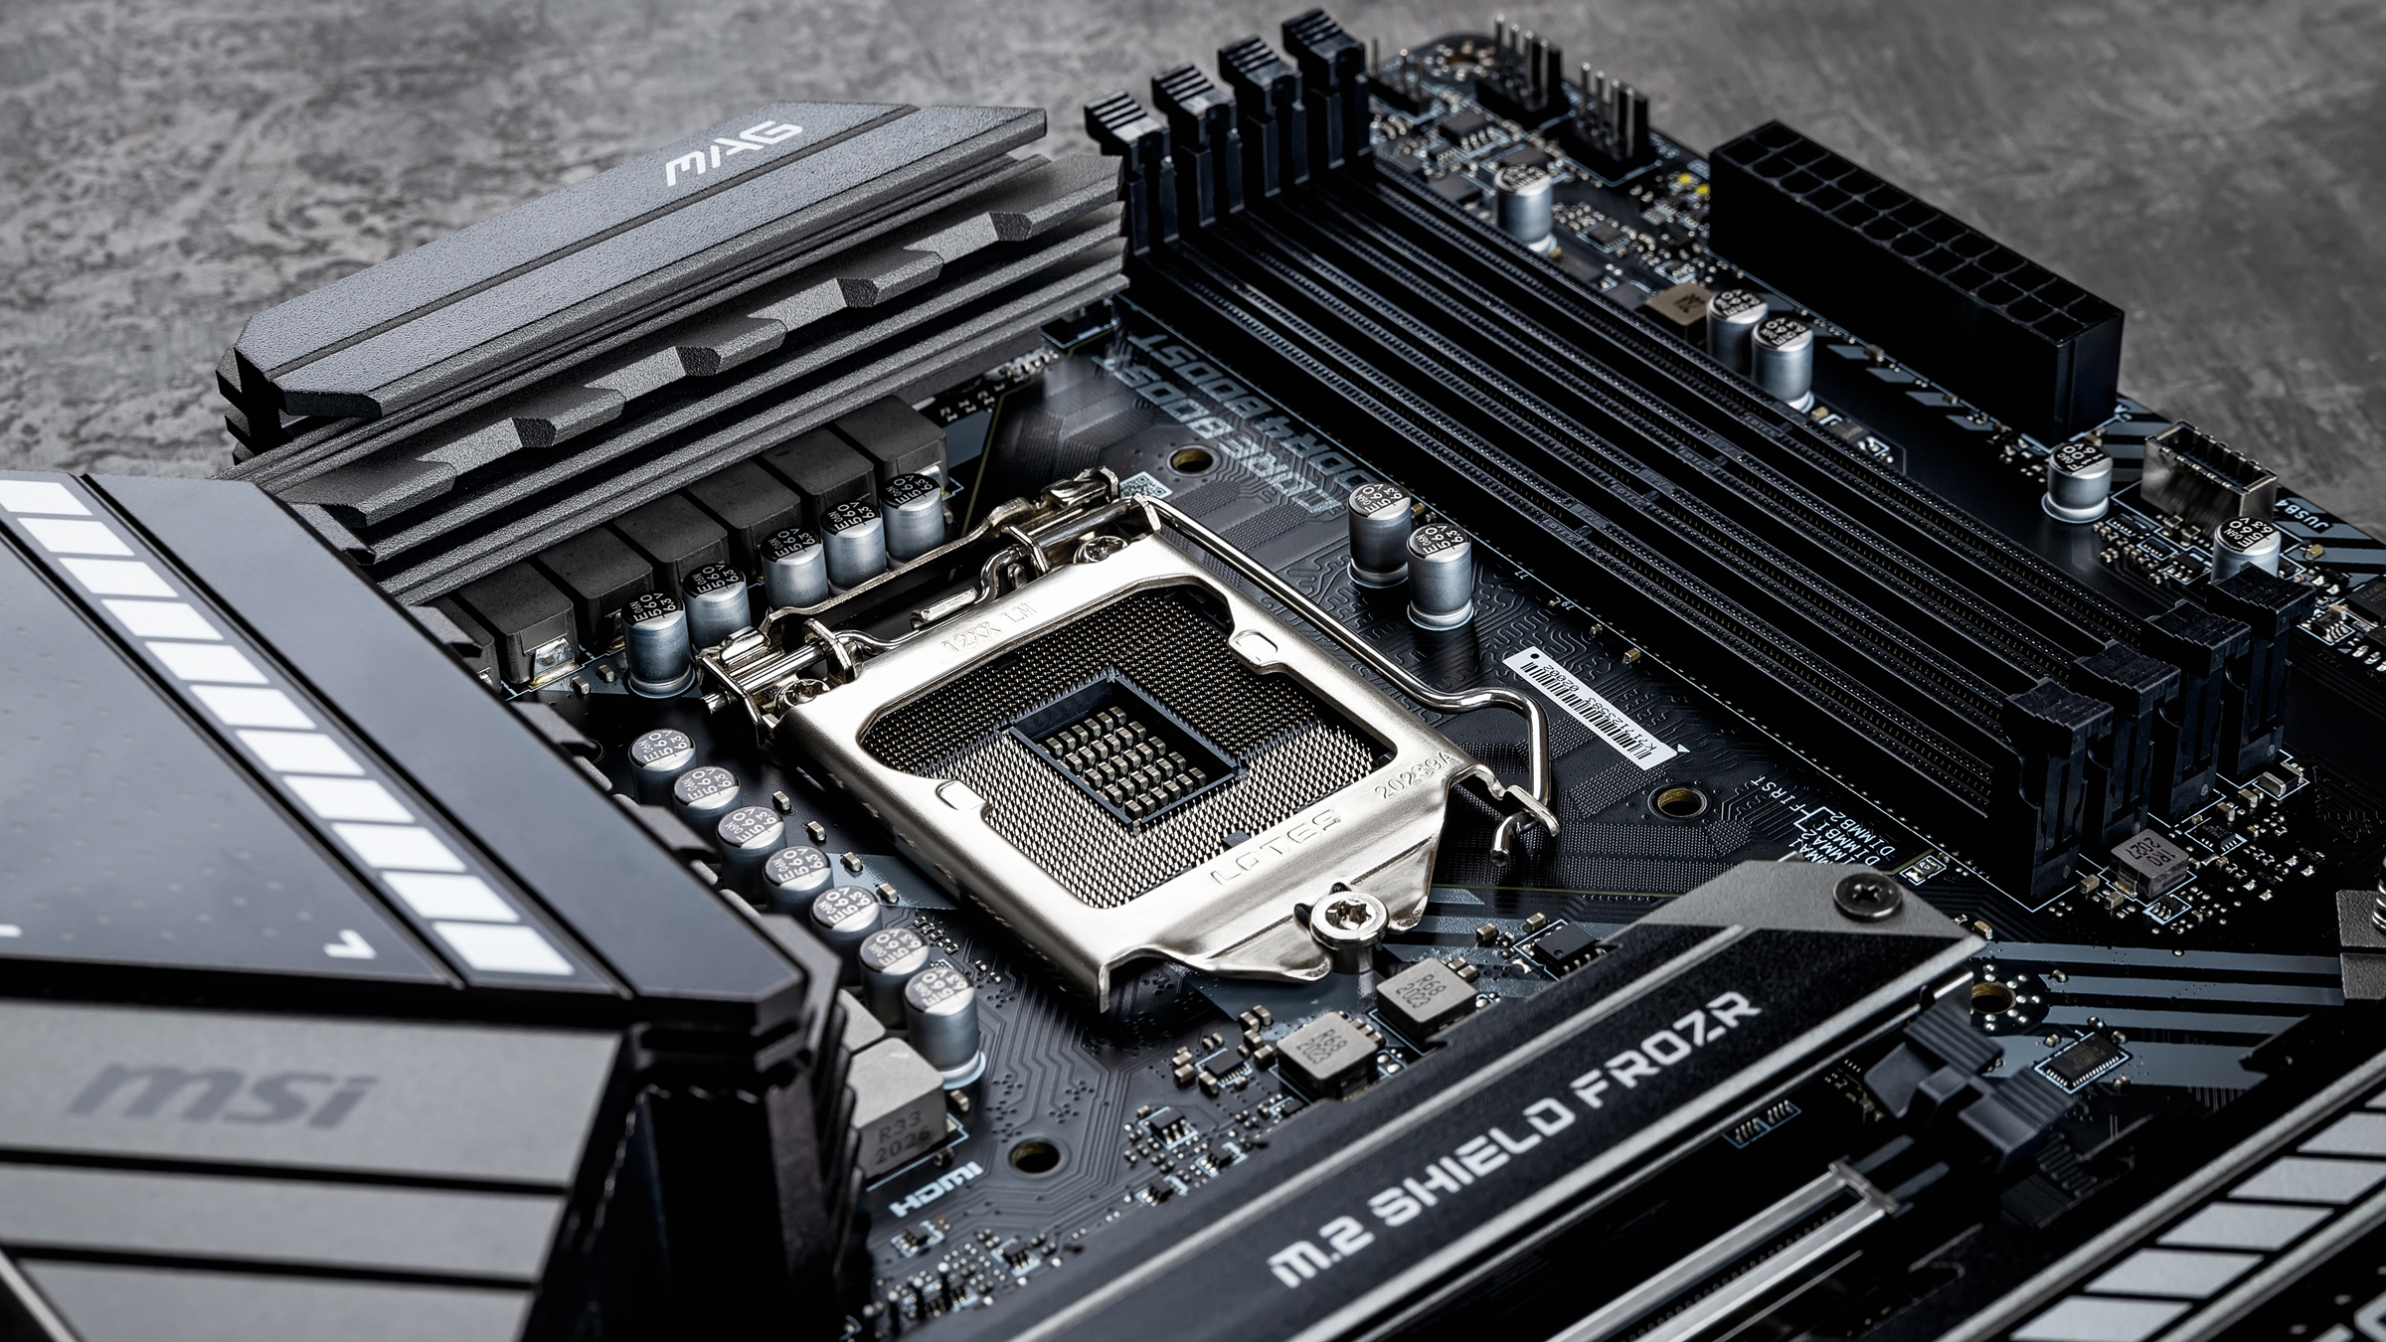

studio shodwe
Home
About us
Startegy
Contact
What is a motherboard?
The motherboard is the heart of the computer and also the most neglected part of the hardware. The main purpose of the motherboard is to connect all parts of a computer such as: memory, processor, disks and other devices in a better and faster way. Unlike other hardware devices development of motherboard is very unique and has a great impact on the market. While other devices developed independently of each other, it depends on the development of the motherboard whether these devices will work together.

Slide 3
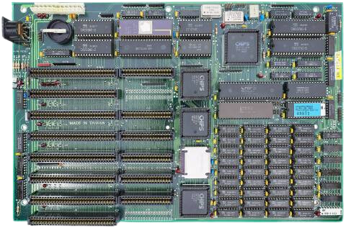
studio shodwe
Home
About us
Startegy
Contact
AT Motherboard
The AT motherboard is typically made of fiberglass with copper or aluminum traces for electrical conductivity. It uses a two-row pin power connector (P8 and P9 connectors) to connect to the power supply. It supports older CPU sockets like Socket 7 or Socket 370 and offers SIMM or early DIMM slots for memory, with capacities ranging from 16 MB to 64 MB. Chipsets from Intel, Via, or Sis are common. The BIOS is basic, used for system boot and configuration. For expansion, it includes 3–4 ISA and PCI slots. Storage relies on older IDE interfaces. Built-in features are minimal, often requiring add-on cards for sound, video, and network functionality. Modern connectivity like USB is absent.

Slide 4
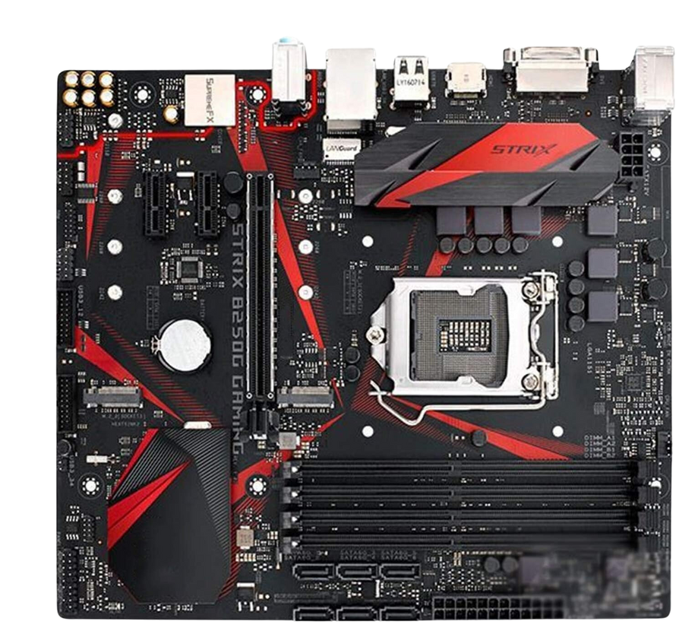
studio shodwe
Home
About us
Startegy
Contact
ATX Motherboard
The ATX motherboard is made of durable, multilayered PCB designed for high-performance computing. It has a single CPU socket that supports Intel or AMD processors, depending on the model. Memory slots range from 2 to 4 DIMMs, supporting DDR4 or DDR5 RAM. Common chipsets include Intel Z790 and AMD B650. The BIOS is UEFI with a graphical interface and advanced settings. Expansion options include 1–2 PCIe x16 slots and 2–4 PCIe x1 slots. It has 4–6 SATA 3.0 ports for storage. Built-in features include onboard audio, Ethernet, USB 3.2 ports, and M.2 slots for NVMe storage.

Slide 5
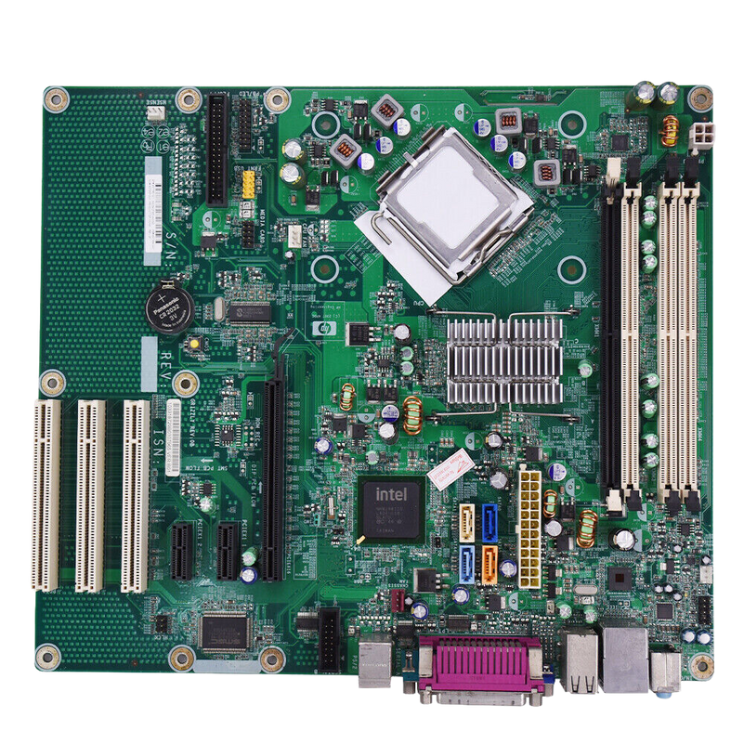
studio shodwe
Home
About us
Startegy
Contact
BTX Motherboard
The BTX motherboard features a Balanced Technology Extended design focused on efficient cooling and airflow, often larger than ATX boards. It has a single CPU socket, compatible with Intel processors like Pentium 4 and later models. Memory slots usually support DDR or DDR2 RAM, with capacities ranging from 4 GB to 8 GB. Common chipsets include Intel's 915/925 series. It uses a text-based BIOS for system customization. For expansion, it offers 3–4 PCI or PCIe slots. Storage includes 2–4 SATA ports. Built-in features include improved thermal design, with some models integrating audio and Ethernet.

Slide 6
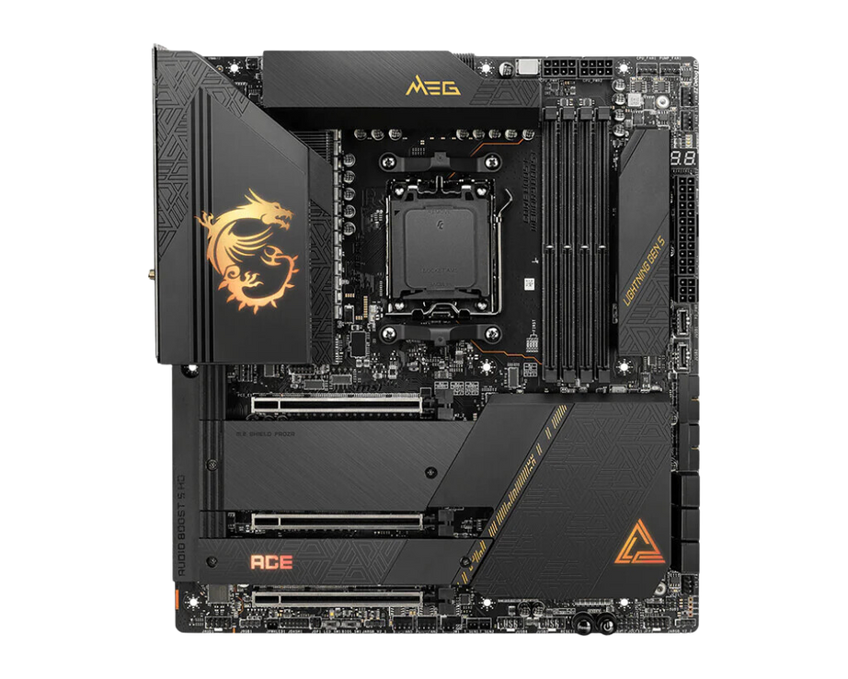
studio shodwe
Home
About us
Startegy
Contact
Extended-ATX Motherboard
The Extended-ATX motherboard is a large form factor ideal for high-performance gaming, workstations, and servers. It supports one or two CPU sockets for Intel or AMD processors. Memory slots range from four to eight, supporting up to 256 GB or more of DDR4/DDR5 RAM in dual or quad-channel configurations. Chipsets include Intel X299, Z790, and AMD TRX40, WRX80. The UEFI BIOS offers features like overclocking and secure boot. Expansion includes 3–5 PCIe x16 slots and additional PCIe x4/x1 slots. Storage options include 6–12 SATA III ports. Built-in features often include Wi-Fi, Bluetooth, USB 3.2/4, Thunderbolt 4, HDMI, and advanced cooling support.

Slide 7
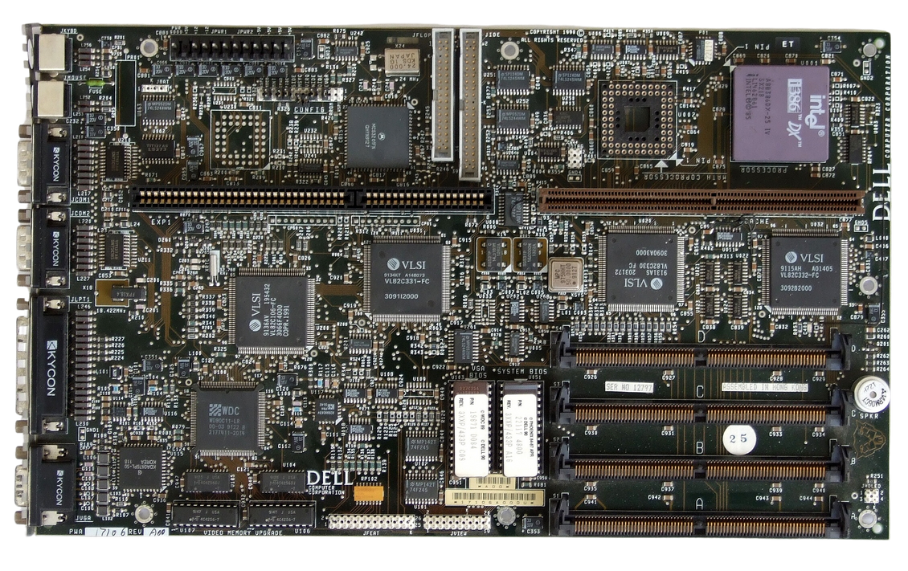
studio shodwe
Home
About us
Startegy
Contact
LPX Motherboard
The LPX motherboard measures about 13 × 9 inches and has a low-profile design. It supports Socket 7 for Pentium processors up to 200 MHz. It has four 72-pin SIMM sockets for memory, with a maximum capacity of 128 MB. Common chipsets include Intel's 82430HX PCIset. Its BIOS firmware is stored in non-volatile memory. Expansion is provided through a riser card, with multiple PCI and ISA slots. SATA is not supported; storage uses IDE interfaces. Some models include built-in features like integrated audio and USB controllers.

Slide 8
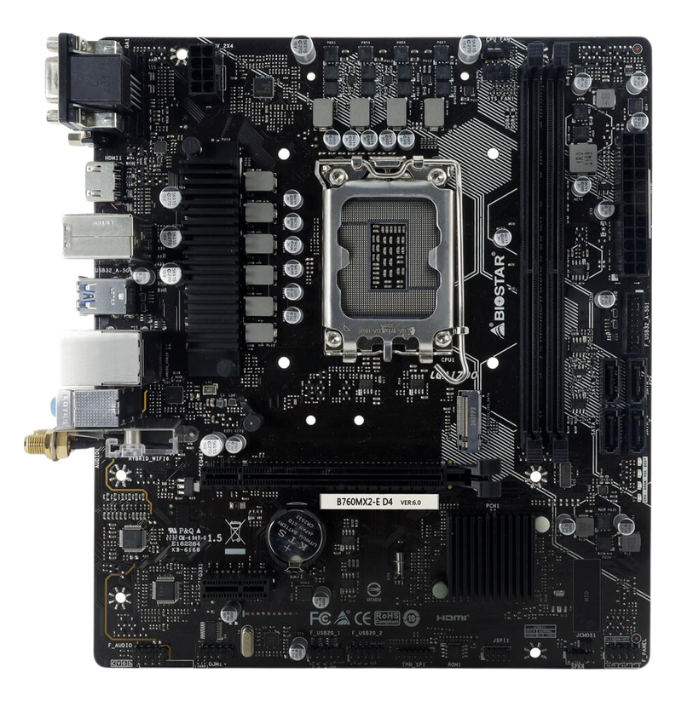
studio shodwe
Home
About us
Startegy
Contact
Micro-ATX Motherboard
The Micro-ATX motherboard measures 244mm x 244mm, smaller than ATX but larger than Mini-ITX, offering a balance of compactness and functionality. It supports modern CPU sockets like AMD’s AM5 and Intel’s LGA 1700. Memory slots usually include 2–4 DIMMs for DDR4 or DDR5 RAM. Common chipsets are AMD B550, B650, and Intel B760. The BIOS is user-friendly, with features like overclocking and hardware monitoring. Expansion includes one PCIe x16 slot for GPUs and additional PCIe x1 slots. Storage includes multiple SATA ports and at least one M.2 slot. Built-in features include integrated Wi-Fi, RGB lighting control, and robust VRM cooling.

Slide 9
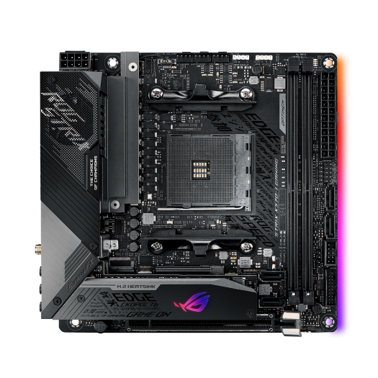
studio shodwe
Home
About us
Startegy
Contact
Mini-ITX Motherboard
The Mini-ITX motherboard is ultra-compact and ideal for small form factor PCs. It has one CPU socket for Intel or AMD processors. Memory support includes two DIMM slots for up to 32 GB or 64 GB of RAM, depending on the model. Chipsets include Intel H610, B660, Z690, and AMD B550, X570. The UEFI BIOS offers advanced features like overclocking. Expansion includes one PCIe x16 slot. Storage options include 2–4 SATA III ports. Built-in features often include Wi-Fi, Bluetooth, high-speed USB ports, and compact power delivery components.

Slide 10
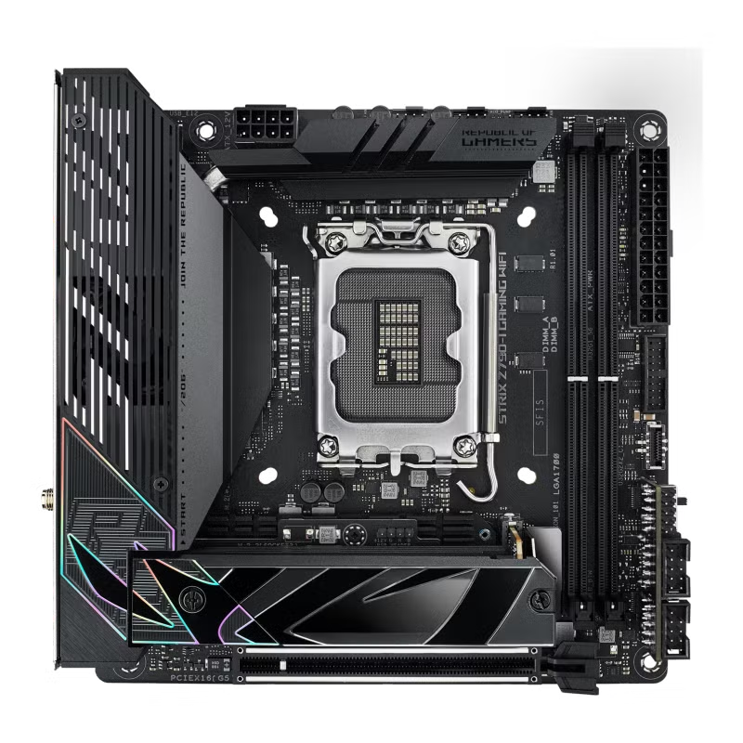
studio shodwe
Home
About us
Startegy
Contact
Mini-ATX Motherboard
The Mini-ATX motherboard is compact, designed for small PCs. It has one CPU socket compatible with Intel or AMD processors. Memory slots support dual-channel configurations with up to 64 GB of RAM. Chipsets include Intel H610, B660, Z690, and AMD B550, X570. The UEFI BIOS is user-friendly with advanced customization options. Expansion includes one PCIe x16 slot and one PCIe x1 slot. Storage options include four SATA ports. Built-in features often include Wi-Fi, Bluetooth, USB 3.2, HDMI, and RGB lighting.
Page 07

Slide 11
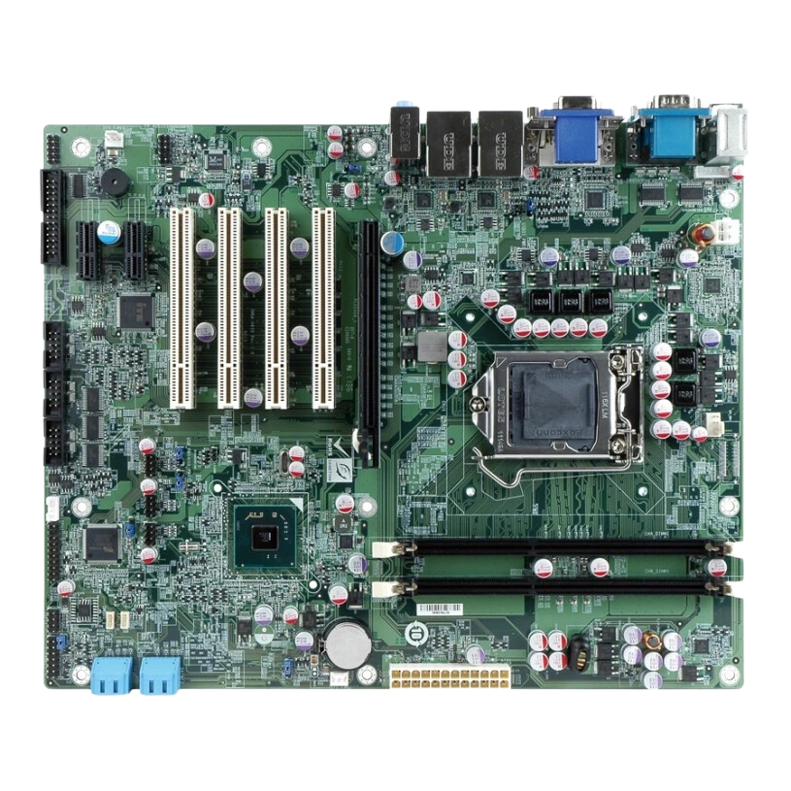
studio shodwe
Home
About us
Startegy
Contact
Pico-BTX Motherboard
The Pico-BTX motherboard is a smaller version of the BTX form factor, designed for compact PC builds. It supports a single CPU socket for Intel or AMD processors. Memory slots typically include 4 DDR2 DIMM slots for up to 8 GB of RAM. Chipsets vary, with examples like Intel 915 or AMD 690G. It includes a single PCIe x16 slot for graphics. Storage is supported through 4 SATA ports. Built-in features may include USB, HDMI, Ethernet, and audio ports.

Slide 12
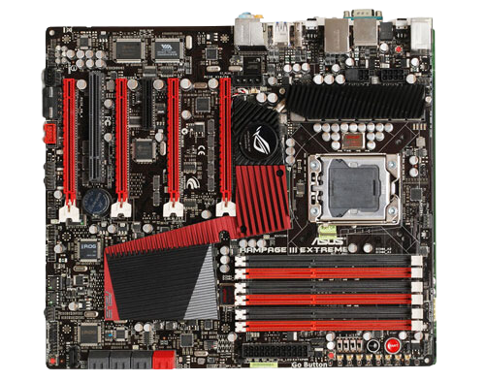
studio shodwe
Home
About us
Startegy
Contact
Standard ATX Motherboard
The Standard ATX motherboard measures 305mm x 244mm. It has one CPU socket, supporting Intel or AMD processors. Memory slots usually include four DIMMs for dual or quad-channel configurations. Chipsets vary, such as Intel Z690 and AMD X570. The BIOS handles system settings and hardware configuration. Expansion includes multiple PCIe slots for graphics cards and other add-ons. Storage uses multiple SATA ports. Built-in features include USB, HDMI, Ethernet, and audio ports.

Slide 13
studio shodwe
Home
About us
Startegy
Contact
References
Szewczyk, C. (2024, September 11). Best Mini-ITX motherboards in 2024: My pick from all the mini mobo marvels I’ve tested. Pcgamer. https://www.pcgamer.com/hardware/motherboards/best-mini-itx-motherboards/?form=MG0AV3
Gaming Motherboard Buying Guide - Intel https://www.intel.com/content/www/us/en/gaming/resources/how-to-choose-a-motherboard.html
Problem With LPX DDR4 and Gigabyte Motherboard https://forum.corsair.com/forums/topic/181081-problem-with-lpx-ddr4-and-gigabyte-motherboard/
James, J. (2024, January 10). CES 2024 round-up: Cable-free motherboards & cases, and the latest PC components. MSI. https://www.msi.com/blog/ces-2024-round-up-cable-free-motherboards-cases-and-the-latest-pc-components
James, J. (2024b, June 4). Computex 2024 round-up: Latest motherboards and PC components, innovative and powerful. MSI. https://www.msi.com/blog/computex-2024-round-up-latest-motherboards-and-pc-components
https://eiratek.com/different-types-of-motherboard/?srsltid=AfmBOooQY-dvG2-ACEubEWeP26_4Y_i5DMWZknclV5mewTH63lGVHSsf
https://www.cwc-group.com/dg965pz.html
Shimpi, A. L. (2004, June 2). Computex 2004: BTX at the Show. AnandTech. https://www.anandtech.com/show/1340/3?form=MG0AV3
eComputerTips. (2020, August 16). What is an ATX Motherboard? https://ecomputertips.com/glossary/atx-motherboard?form=MG0AV3
Tomljanovic, J., Turina, T., & Kurelovic, E. K. (2013). Motherboard and user experience. https://www.semanticscholar.org/paper/Motherboard-and-user-experience-Tomljanovic-Turina/dc6ad6d29c4a510a3b91529df1c51f57fc610a4f

Slide 14
studio shodwe
Home
About us
Startegy
Contact
Thank You
Thank You
Thank You

